Slide 1
-
Smart Cities- Smart BKC 1.0
Mumbai Metropolitan Region Development Authority

Slide 2
Agenda
Cities and its Challenges
What is Smart City ?
Smart City Initiatives
“The cities of the 21st century are the largest sites of human settlement today, and are increasingly acting as critical nexus points of social, economic, ecological and technological change”
United Nations Environment Program (UNEP)
Smart BKC
Global Examples
Videos

Slide 3
Cities and its Challenges

Slide 4
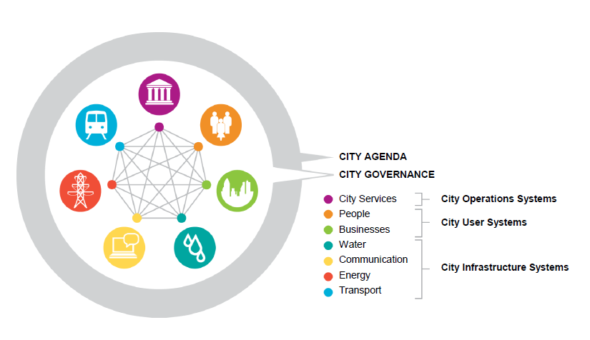
Today’s City and its key challenges
A city is a microcosm of the major challenges and opportunities facing the planet today—intensified and accelerated. Here, all man-made systems come together and interact with one another.
Four key global trends that is driving change in city development
Trend #1: Urbanization is straining infrastructure
Trend #2: Resource constraints demand efficiency
Trend #3: Competition between cities is increasing
Trend #4: New technologies are driving urban innovation

Slide 5
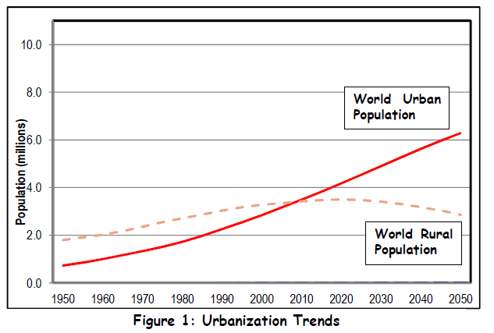
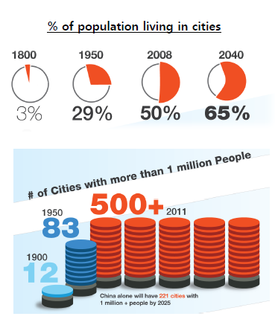
Trend # 1: Urbanisation - Straining City Infrastructure
The global population is now predominantly city-dwelling, as a result demand is increasing for urban infrastructure investment
In 2008 for the first time in history the urban population equalled the rural population of the world
By 2030 this number is expected to swell from 3.3bn to 5bn people.
Notes:
The global population is now predominantly city-dwelling and as a result demand is increasing for urban infrastructure investment.
In 2008 for the first time in history the urban population equalled the rural population of the world. By 2030 this number is expected to swell from 3.3bn to 5bn people.
This is especially prevalent in developing countries such as China and India, where 300-250 million people in each country will move from rural areas to cities within the next 20 years (that is the equivalent of the entire US population moving into cities).

Slide 6
Trend # 1: Growth of Urban Population in India 1901 - 2001
India is expected to witness an increase in urban population from 377 million in 2011 to 600 million (roughly twice the current population of the United States) in 2031.
With an urban population of 31%, India is at a point of transition where the pace of urbanization will speed up till it reaches about 60 – 65%
Given these numbers, the country is expected to have around 68 cities with population of more than 1 million by 2030.
This is the opportunity to reap twin benefits of young demographics and urbanization

Slide 7
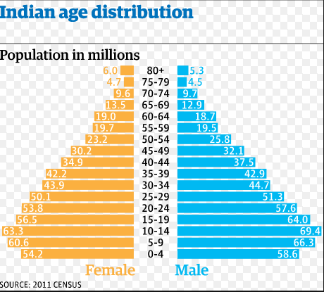
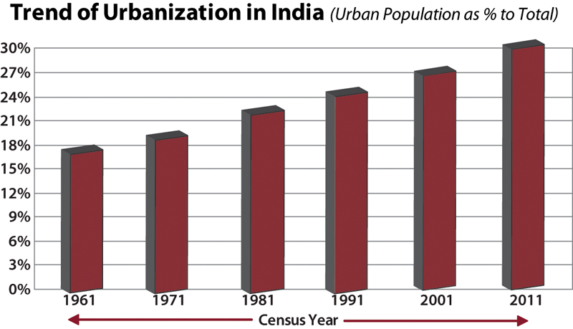
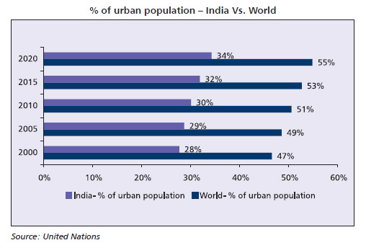
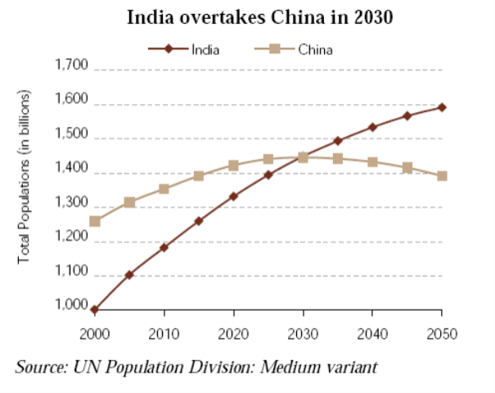
Trend # 1: Growth of Urban Population

Slide 8
Trend # 1: Growth of Class 1 Cities

Slide 9
Trend # 2: 71% of CO₂ emissions are from cities
Cities have a huge pull on the world’s finite global resources (fossil fuels, water etc);
Cities are major consumers and polluters. Despite only occupying 2% of land, cities today account for over two-thirds of the world’s energy consumption.
This energy use translates into 19.8 Gt of CO2 emissions from cities — roughly 71% of global energy-related CO2 emissions.
By 2030 the share of cities in global CO2 emissions is expected to rise to 76%
City Energy-related CO₂ emissions
(as a % of the rest of the world)
31
Gigatonnes
25
20
71%
74%
76%
2006
2020
2030
Source: World Bank
Share of cities in world
Gt CO2e
We are also seeing the vulnerability of cities to the effects of climate change e.g. Flash floods, Hurricane Sandy etc.
Notes:
Cities have a huge pull on the world’s finite global resources (fossil fuels, water etc); Cities are major consumers and polluters. Despite only occupying 2% of land, cities today account for over two-thirds of the world’s energy consumption. This energy use translates into 19.8 Gt of CO2 emissions from cities — roughly 71% of global energy-related CO2 emissions.
By 2030 the share of cities in global CO2 emissions is expected to rise to 76%
We are also seeing the vulnerability of cities to the effects of climate change e.g. Hurricane Sandy and New York.

Slide 10
Trend # 3: Cities Adding to GDP
Just like companies compete for customers, cities are increasingly competing to attract the best talent, and to attract businesses. Major urban areas today are economic giants.
The top 5 urban economies (Toyko, NYC, Los Angeles, London and Chicago) are having to increasingly compete with emerging economy cities.
As this league table shows, by 2025 Sao Paulo, Mexico City, Shanghai, and Buenos Aires will rise higher in the GDP rank – ranking 6th, 7th, 9th and 10th respectively.
And in 11th place will be Mumbai rising from 29th place in 2008.
The center of gravity of the earth’s urban landscape is shifting decisively, and at speed - moving south and east – to China, India and Latin America.
Top 10 Cities by GDP
GDP Rank | 2008 | 2025
1 | Tokyo | Tokyo
2 | New York | New York
3 | Los Angeles | Los Angeles
4 | Chicago | London
5 | London | Chicago
6 | Paris | Sao Paulo
7 | Osaka/Kobe | Mexico City
8 | Mexico City | Paris
9 | Philadelphia | Shanghai
10 | Sao Paulo | Buenos Aires
11 |  | Mumbai
29 | Mumbai

Slide 11
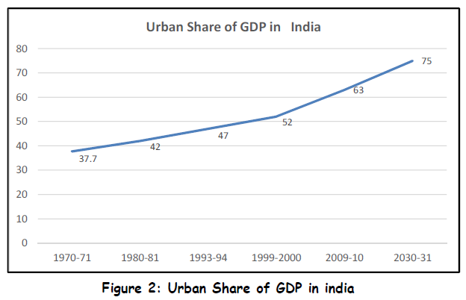
Trend # 3: Cities are referred to as the “engines of economic growth”
While the urban population is currently around 31% of the total population, it contributes over 60% of India’s GDP.
It is projected that urban India will contribute nearly 75% of the national GDP in the next 15 years.
It is for this reason that cities are referred to as the “engines of economic growth”

Slide 12
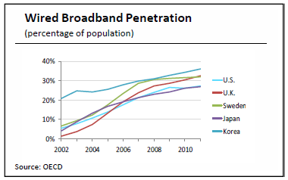
Trend # 4: New technologies are driving urban innovation (1/2)
The final trend, is the growing use of technology within cities
The penetration of broadband is increasing around the world,
People are increasingly acting like sensors
Citizens are participating in the design of their city environments; acting as ‘prosumers’ (both producers and consumers)
India
Cities have become more popular and the internet has improved city life
India’s BB penetration is just 2%
10% rise in BB connections lead to 1.3% rise in GDP

Slide 13
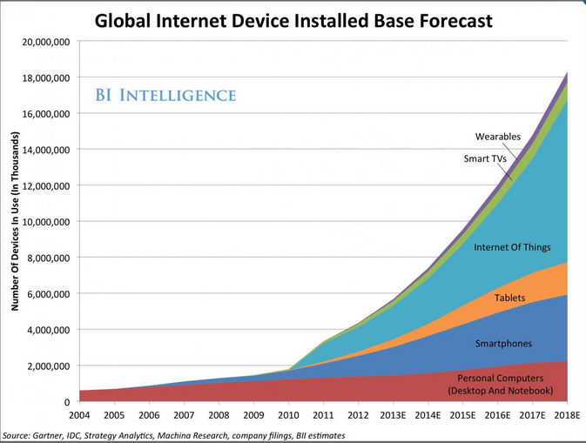
Trend # 4: The World is moving towards Internet of Things which is the backbone for Smart Cities

Slide 14
Hence, Cities require smarter solutions
The systems are under increasing environmental, social and economic pressures
For sustainable prosperity, the systems need to be managed optimally
The systems need to become smarter

Slide 15
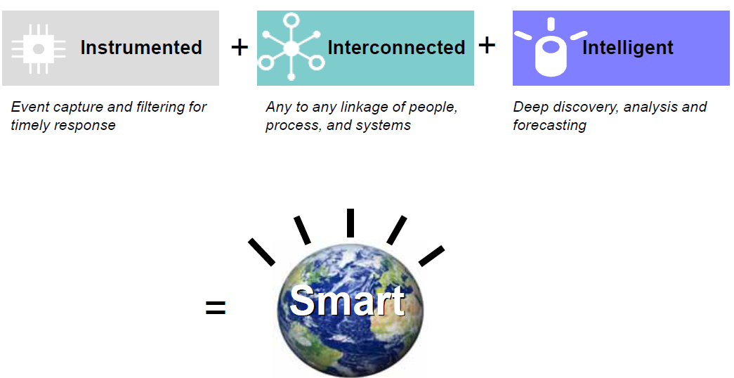
Smart solutions are instrumented, interconnected and intelligent

Slide 16
What is Smart City?

Slide 17
Definitions of Smart City
The UK Department of Business, Innovation and Skills considers smart cities a process rather than as a static outcome, in which increased citizen engagement, hard infrastructure, social capital and digital technologies make cities more livable, resilient and better able to respond to challenges.
The British Standards Institute defines it as “the effective integration of physical, digital and human systems in the built environment to deliver sustainable, prosperous and inclusive future of its citizens”.
IBM defines a smart city as “one that makes optimal use of all the interconnected information available today to better understand and control its operations and optimize the use of limited resources”.
CISCO defines smart cities as those who adopt scalable solutions that take advantage of information and communications technology (ICT) to increase efficiencies, reduce costs and enhance the quality of life”.
Wikipedia defines a city as Smart when investments in human and social capital and traditional (Transport) and modern (ICT) communications infrastructure fuel sustainable economic development and a high quality of life, with a wise management of natural resources, through participatory action and engagement (Caragliu et al, 2009)
Frost & Sullivan defines as “Smart cities are an evolved state of urbanization where application of technology integrates diverse individual entities such as buildings, utilities, authorities, infrastructure and industries.”
In short, a smart city is one that uses information technology to solve urban problems

Slide 18
An urban center that is workable and sustainable over a long period is what defines a true “Smart City”
Simplifying Smart City: A Smart City effectively delivers public and civil services to citizens and businesses in an integrated and resource efficient way while enabling innovative collaborations to improve quality of life and grow the local and national economy focusing on three key factors
Notes:
To improve its attractiveness and reduce environmental impact
To provide a platform for Innovative public and private sector collaboration
To encourage new business, governance and financing models
To promote tourism through intelligent city solutions
To integrate across urban systems and increase quality of outcomes (social, environmental and economic):

Slide 19
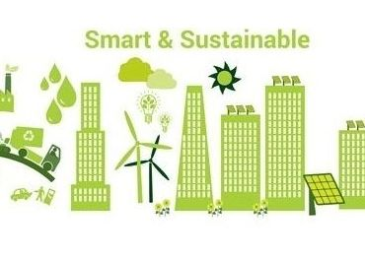
Smart Cities Can Be Identified along Six primary Axes
Smart Living
Smart People
Smart Economy
Smart Government
Smart Environment
Smart Mobility

Slide 20
Pillars of Smart City
Quality of Life
Physical Infrastructure
Power
Water Supply & Sewerage
Social Infrastructure
Education
Institutional Infrastructure
Solid Waste Management
Multimodal Transport
Connectivity
Housing
Disaster Management
Cyber Connection
Healthcare
Entertainment
Inclusive Planning
Building Homes
Speedy Service Delivery
Enforcement & Security
Taxation & Institutional Finance
Skill Development
Environment Sustainability
ICT based service delivery
People Participation

Slide 21
Benchmarks of Smart City (1/3)
Sl.No. | Parameter | Benchmark
A | Transport | Maximum travel time of 30 minutes in small & medium size cities and 45 minutes in metropolitan areas Continuous unobstructed footpath of minimum 2m wide on either side of all street with RoW 12m or more Dedicated and physically segregated bicycle tracks with a width of 2mor more, one in each direction, should be provided on all streets with carriageway larger than 10m (not ROW) High quality and high frequency mass transport within 800m(10-15 minute walking distance) of all residences in areas over 175persons / ha of built area Access to para-transit within 300m walking distance.
B. | Spatial Planning | 175 persons per Ha along transit corridors. 95% of residences should have daily needs retail, parks, primary schools and recreational areas accessible within 400m walking distance. 95% residences should have access to employment and public and institutional services by public transport or bicycle or walk At least 20% of all residential units to be occupied by economically weaker sections in each Transit Oriented Development Zone 800m from Transit Stations At least 30% residential and 30% commercial/institutional in every TOD Zone within 800m of Transit Stations
C. | Water Supply | 24 x 7 supply of water 100% household with direct water supply connections 135 litres of per capita supply of water 100% metering of water connections 100% efficiency in collection of water related charges

Slide 22
Benchmarks of Smart City (1/3)
Sl.No. | Parameter | Benchmark
D. | Sewerage &Sanitation | 100% households should have access to toilets 100% schools should have separate toilets for girls
E. | Solid Waste Management | 100% households are covered by daily door-step collection system. 100% collection of municipal solid waste 100% segregation of waste at source, i.e. bio- degradable and non-degradable waste 100% recycling of solid waste
F. | Storm Water Drainage | 100% coverage of road network with storm water drainage network Aggregate number of incidents of water logging reported in a Year = 0 100% rainwater harvesting
G. | Electricity | 100% households have electricity connection 24 x 7 supply of electricity 100% metering of electricity supply 100% recovery of cost Tariff slabs that work towards minimizing waste
H. | Telephone connections | 100% households have a telephone connection including mobile
I. | Wi-Fi Connectivity | 100% of the city has wi-fi connectivity 100 Mbps internet speed

Slide 23
Benchmarks of Smart City (2/3)
Sl.No. | Parameter | Benchmark
J. | Health Care Facilities | Availability of telemedicine facilities to 100% residents 30 minutes emergency response time 1 dispensary for every 15,000 residents Nursing home, child, welfare and maternity, centre - 25 to 30 beds per lakh population Intermediate Hospital (Category B) - 80 beds per lakh population Intermediate Hospital (Category A) - 200 beds per lakh population Multi-Speciality Hospital - 200 beds per lakh population Speciality Hospital - 200 beds per lakh population General Hospital - 500 beds per lakh population 10020Family Welfare Centre for every 50,000 residents 1 Diagnostic centre for every 50,000 residents 1 Veterinary Hospital for every 5 lakh residents 1 Dispensary for pet for every 1 lakh residents
K. | Education
1. | Pre Primary to Secondary Education | Area equivalent to 15% of residential area for building hospitals 1 Pre Primary/ Nursery School for every 2,500 residents 1 Primary School (class I to V) for every 5,000 residents 1 Senior Secondary School (Cass VI to XII) for every 7,500 residents 1 integrated school (Class I to XII) per lakh of population 1 school for physically challenged for every 45,000 residents 1 school for mentally challenged for 10 lakh population

Slide 24
Benchmarks of Smart City (3/3)
Sl.No. | Parameter | Benchmark
2. | Higher Education | 1 college per 1.25 lakh population 1 university 1 technical education centre per 10 lakh population 1 engineering college per 10 lakh population 1 medical college per 10 lakh population 1 other professional college per 10 lakh population 1 paramedical institute per 10 lakh population • 1 veterinary institute
L. | Fire Fighting | 1 fire station per 2 lakh population / 5-7km radium 1 sub – fire station with 3-4 km radius
M. | Others | Use of renewable energy in all sectors Rooftop solar panels on all public, institutional and commercial buildings as well as multistoried residential housings Adherence to green building norms Common ducting for all services Double entry accounting on real time basis 3D maps on GIS of property and all services – power, water supply, sewerage etc Cities to formulate building and parking standards

Slide 25
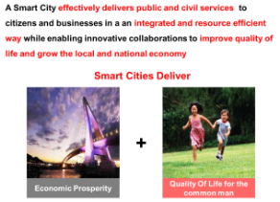
Smart Cities in India will need to meet economic and quality of life objectives
Examples
1
Singapore, Melbourne :
These are high performing cities. Cities need to undertake innovation and smart initiatives to maintain their competitiveness
City Competitiveness Index
Indicative*
High
3
1
2
Varanasi, Trivandrum:
These cities provide its citizens with a high quality of life; however, their economic potential is still untapped
Economic Prosperity includes:
Business environment
Job creation
Economic productivity
Labor laws & regulations
Quality of Life includes:
Physical and social infrastructure
Environmental Sustainability
Community Development
Need to enhance quality of life
Future Cities
Economic Prosperity
3
Vapi, Gurgaon:
These cities have high economic growth driven by industrial, service or other sectors; however the cities face basic urban issues such as mobility, air quality, etc
Unlock competitive advantage to drive economic prosperity
Need complete transformation
4
Faridabad
These cities need a major transformation as they are low on economic prosperity as well as quality of life.
Low
4
2
Low
Quality of Life
High

Slide 26
Smart City Initiatives

Slide 27
Select initiatives would be the backbone and other initiatives would follow as value additions
Collaboration and Interaction
Video Conferencing
Enterprise Social Network
Citizen Intelligence
Interactive Sidewalks
Digital public displays
Interactive Sidewalks
Communication Networks
Internet Backbone
Wireless Hotspots
Mobile Backbone
Data Management Services
Mobile Backbone
Crowd sourced traffic information
Financial Services
Clearing and Settlement Services
Trading Surveillance
Retail Services
Digital Advertising
Mobile Marketing
Retail Analytics
Smart Logistics
Mobile Applications
E-payments
Security
Biometric Access
Video Analytics
Emergency Response Systems
Mobility and Accessibility
Intelligent Parking
Vehicle Management Systems
Transport Management Systems
Electric Vehicle Capabilities
VMT Reduction Systems
Digital public displays
Utilities
Energy Efficiency
Water Efficiency
Waste Management Systems
Building Management System
Smart Building Installations
Pollution Meters
City Management
Urban Operating System
Sustainability Performance Management
Central Command Center
E-Commerce
Intelligent Waste Management
Pollution Meters

Slide 28
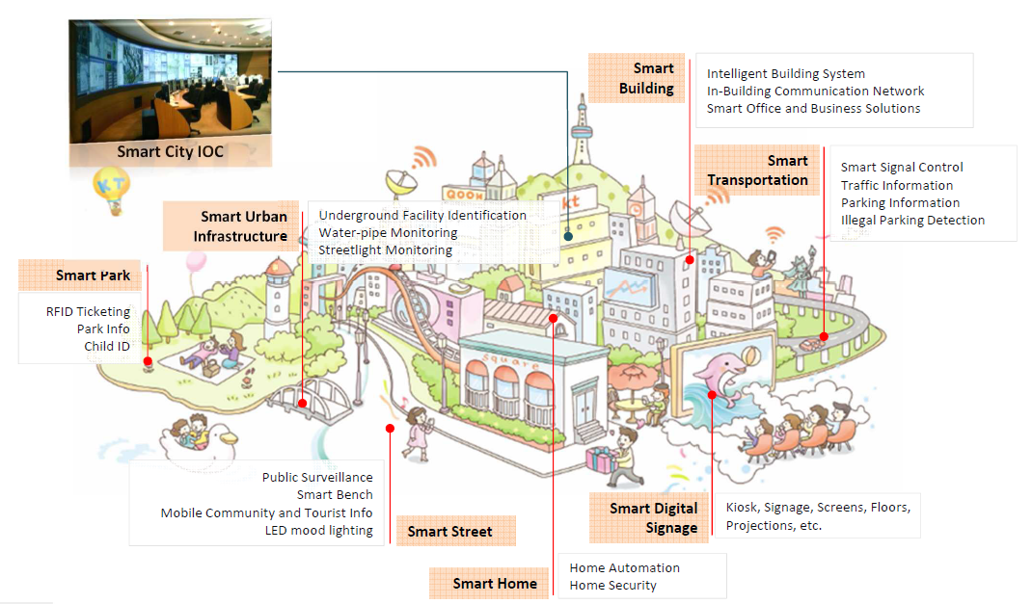
Smart City at a glance

Slide 29
Smart Cities Agenda- India & Global

Slide 30
National governments are driving the Smart City agenda forward
The government of India is planning to develop 100 smart cities in country
45 cities with one to four million people under consideration for up-gradation to a smart city
Govt. has allocated INR 7060 Cr for Smart Cities
Delhi-Mumbai industrial corridor to be great opportunity to build several smart cities in the next two decades.
Ministry of Urban Development is working on new framework for developing smart cities in India
China has selected 90 pilot cities for smart city projects, announced by the Ministry of Housing and Urban-Rural Development
Provide fast and effective information services in areas such as traffic management, healthcare and environmental protection by using advanced ICT
China Development Bank will lend as much as 80 billion yuan (INR 70,000 Crores) for the projects between 2013 and 2015
UK Government, through the Technology Strategy Board, begun heavily investing in Future Cities
There will be a £24 million investment in Glasgow City, as the Future Cities Demonstrator over 18 months
London, awarded the Future Cities Catapult, will be funded by up to £50 million over five years

Slide 31
Smart Bandra Kurla Complex
Smart BKC would be showcased as the first Brownfield Smart City in India and Globally benchmarked Intelligent International Finance Centre’

Slide 32
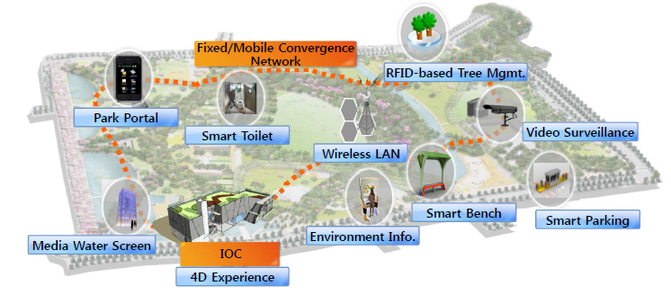
An overview of Smart BKC

Slide 33
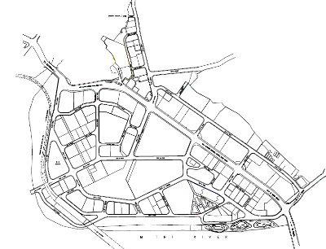
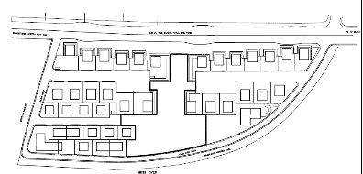
MMRDA envisioned BKC to be an easily accessible, intelligent and sustainable International Financial & Business Hub
BKC was instituted by MMRDA to create an easily accessible, intelligent and sustainable International Financial and Business hub.
BKC houses a number of financial & business houses including National Stock Exchange, SEBI, ICICI Bank, Citibank, Dena Bank, Bank of Baroda, State Bank of India , Jammu & Kashmir Bank National Business Centre, NABARD Head Office, IL&FS, Asian Heart Institute, Dow Chemicals, Bharat Diamond Bourse, Dhirubhai Ambani International School, American School of Bombay & Fortune 500.
It also is home to the Mumbai Cricket Association's cricket ground and the United States Mumbai Consulate.
Open plots in the BKC area are given out on rent to host events and are known as the MMRDA grounds.
E block – 25 Ha
There are 6,40,000 employees working in the BKC area
About 64000 people is assumed to be the floating population that comes to BKC everyday
Apart from this about 1,560,0,000 people visit the MMRDA exhibition grounds every year
Total available office area E & G – 6400000 sqm
Total length of roads in E &G – 20km
G block – 170 Ha

Slide 34
Based on the various smart cities across the globe, a smart city Journey for Bandra Kurla Complex is defined to help achieve this vision
Reactive
Reactive city is today’s city.
Stimulus response
Low operation efficiencies
Proactive
Basic smart city services (Wi-Fi , Parking, Video Analytics etc)
Proactive responses to changing citizen and business need
Smart
Advanced smart city Services
Integrated smart city services (e.g. transport-energy-health-safety)
Predictive response to citizens and business need
High Performance
Digital as a Unique selling point
Proliferation of seamless digital services which improve stakeholders’ quality of life
High
Copenhagen
Leaders
Paris
Vienna
Barcelona
Amsterdam
New York
Toronto
Singapore
Dubai
Phase 3: Futuristic Initiatives
London
Malta
BKC
(2025 Onwards)
Doha
Digitization level, service delivery model, governance
Skolkovo
BKC (2020)
Phase 2: Maturing Technology at BKC
Impact On Performance
BKC
(2017)
Helsinki
Songdo
Average Performers
Iskandar
MADSAR
Phase 1: Intelligent Infrastructure at BKC
Low
KACARE
Laggards
BKC
Low
Stages of a Smart City
High
Notes:
Note: Based on Accenture Analysis and Top Smart City Raning

Slide 35
For BKC the approach is guided by citizen, businesses, economic and environmental needs to select, shortlist and design the Initiatives
Citizen Centricity
Identify & design the Smart City solutions keeping citizen in focus and citizen benefits in focus.
Impact on Climate & Reduction in Carbon footprint
The design should keep in mind the health of the planet and be able to showcase a reduction in carbon emissions
Intelligent BKC
User Friendliness & Ease of usage
Design the Smart city solution to ensure ease of usage for public at large. The design should be intuitive to use
Economic Sustainability of Projects
Where possible the solutions should be financially sustainable with innovative cost recovery/revenue generation mechanism
Citizen Privacy
The privacy of the public should be kept in mind and all solutions should safeguard it
Continuous Innovation
The solutions should be robust enough to be able to be upgraded continuously when better innovations rise up

Slide 36
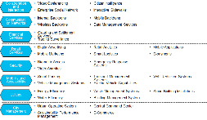
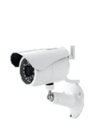
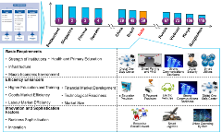
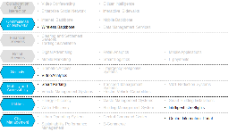
Leveraging stakeholder analysis, best practices and opportunity assessment the five Intelligent Cities initiatives are shortlisted
1
2
3
Stakeholder Analysis & Best Practices Survey
Opportunity Assessment
Phase 1 Initiatives for BKC
Stakeholder analysis to understand the needs and requirements of
residents,
visitors ,
commercial tenants and
MMRDA Officials .
Conducted In Person interviews and fact finding surveys
Best Practice Analysis and Benchmarking
Opportunity Analysis to identify long list of initiatives
Identified five Solutions and Solution
Wi-Fi
Smart Parking
Initiatives are prioritized to arrive at top 5 quick wins for BKC region on consultation held with MMRDA officials, BKC tenant stakeholders and fact finding surveys
Intelligent Streetlights
Video Analytics
Citizen App

Slide 37
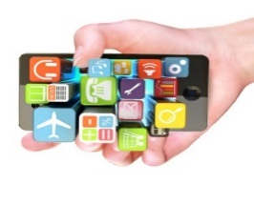
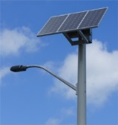
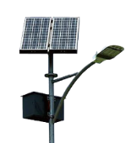
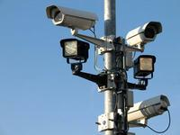
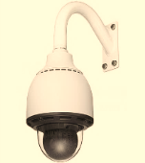
5 initiatives earmarked for Smart BKC 1.0, Making BKC as a Smart City
1.Public WIFI | 2. Smart Parking | 3. Smart Street Lighting & Grid | 4. Video Analytics & Surveillance | 5. Citizen Apps
5 MBPS High Speed Wireless Internet Connectivity | 3000 Smart Parking Slots | 841 Streetlights based on Solar power | Complete E & G Block covered with 90 cameras | 33000 man-days saving due to ease of access of information
175 Hectare Area Covered in Public Wi-Fi in BKC | Parking Time Reduced from 20 minutes to 5 minutes | 800 tonnes of Carbon Reduced Annually | Greater coordination among Security Agencies | Improves Citizen Communication
Seamless Wi-Fi Connectivity Across E& G Blocks | 19000 Liters of Fuel saved annually | Energy Consumption reduced by 40% | Reduced Street furniture theft | Improved Emergency Alert and Response
50,000 man days saved per year | 24 tonnes of Carbon Reduced Annually | 200KW of Clean energy generated | Improved Emergency Response | 6.5 lakhs Employees Covered
Public Wi-Fi as Value Added service for Business and Exhibition Use | Reduction in Unauthorized Parking | Reduced Maintenance Cost | Secured Business Environment | Increase in ease of Business in BKC

Slide 38
The BKC wide Wi-Fi solution will provide seamless connectivity to entire E and G block regions at BKC
Solution Details
The entire BKC E and G blocks will be Wi-Fi enabled with 100 Wi-Fi access points
Wi-Fi will also be used as the communication backbone for smart city applications
Wi-Fi Access points will be installed on streetlights where ever possible to provide last mile connectivity.
Each Wi-Fi Access points will be connected with Fiber backbone.
SMS based authentication based security will be implemented as per DOT guidelines
Internet access will be free of cost for first 30 min
Users will have to pay online to get continuous access.
Benefits
Impact
BKC wide Wi-Fi will provide high speed seamless connectivity
It will serve as a backbone for intelligent city applications and sensors.
Incremental revenue streams from several subscription models
Development of robust IT infrastructure and effective channel of communication across MMRDA focus areas
175 Hectare Area Covered in BKC
5 MBPS High Speed Wireless Internet Connectivity
Seamless Wi-Fi Connectivity Across E& G Blocks
Public Wi-Fi as Value Added service for Business and Exhibition Use
50,000 man days saved per year
* Wi-Fi will also act as backbone network for other initiatives

Slide 39
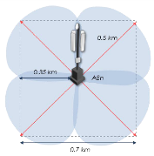
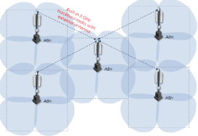
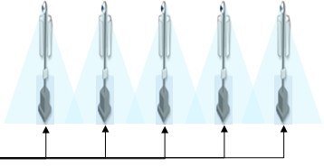
For both the options Wi-Fi Access points will provide last mile connectivity with fiber backbone to ensure high bandwidth (Indicative)
Use Case
(Now and Future)
Case Studies
Design Architecture
Vendor Landscape
Financial Viability
Stakeholder Benefits
Access Points
Fiber Backbone
Signal Coverage
Typical Cluster Structure
Wi-Fi Access Points Connected to Fiber Backbone
Architecture Options
Cellular Architecture
Require less no. of Access Points but users may face disruption in service in overlap regions. Due to non reliability of Wi-Fi , it cannot be used for communication backbone for Smart City.
Mesh Architecture With Fiber Backbone (Preferred)
Require more no. of Access Points to create mesh and users will get seamless connectivity all across without disruptions
Preferred for Smart City application.

Slide 40
The options have also been designed considering the DoT Guidelines on Wi-Fi Security
Use Case
(Now and Future)
Case Studies
Design Architecture
Vendor Landscape
Financial Viability
Stakeholder Benefits
Users with Indian Mobile Number
1. User Connect to Wi-Fi Network
2. Social/Web Identity Authentication: User Ask to Sign-in using one of the below Account
3. SMS Authentication: User Ask to Enter Mobile no.
4. SMS with Code is sent from Server
5. User Enter SMS code and Start internet browsing after successful authentication
Users Without Mobile Number/International Number
2. Social/Web Identity Authentication: User Ask to Sign-in using one of the below Account.
3. Manual Authentication: User Select do not have India mobile
4. Server shows nearest retail store to get coupon. User go-to retail store and submit valid ID proof to get manual code
5. User Enter Manual code and Start internet browsing after successful authentication
1. User Connect to Wi-Fi Network

Slide 41
BKC Wide Wi-Fi architecture will enable secure access to internet after SMS authentication as per DoT guidelines
Use Case
(Now and Future)
Case Studies
Design Architecture
Vendor Landscape
Financial Viability
Stakeholder Benefits
Secure V-LAN with dedicated bandwidth will provide seamless connectivity for Intelligent BKC sensors
Wireless@BKC
Laptop
Mobile
Tablets
Cameras
Sensors
Public Network
Non-Critical
Critical
Premium Network
IoT Network
Virtual LANs
Public Network
Users Connect to Wireless@BKC
User Fill the registration form in landing page
SMS is send with authentication code
User enters code and start using internet using shared bandwidth free for some duration
Premium Network
Users get high-speed and continuous access
IoT( Internet of Things) Network
Network Backbone for Sensors/ Devices and other Applications
Wi-Fi Access Points Mesh Architecture
Firewall
Fiber Backbone
DMZ
SMS Gateway
Internet
Payment Gateway
Wireless Management Server
Intrusion Protection System
Firewall
Router

Slide 42
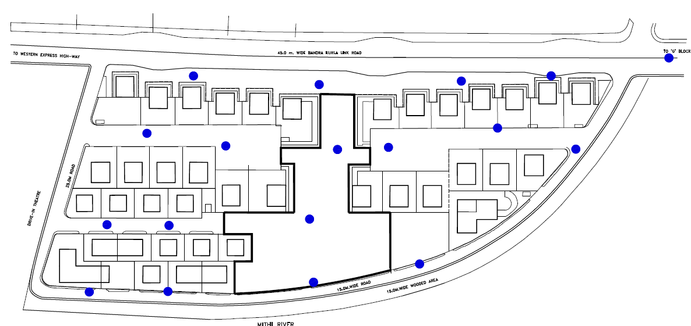
Location Analysis is performed to identify the Wi-Fi access points locations in E- Block to ensure carpet coverage
Family Court
RBI
Income Tax Office
MMRDA
Sales Tax
Food
Plaza
AG
CMC
MSEB
IB
CE
School Plot
BKC Park
Wireless Access Points*: 18
*Wireless access points have been identified in consultation with telecom service provider. Detailed feasibility study will be done during implementation

Slide 43
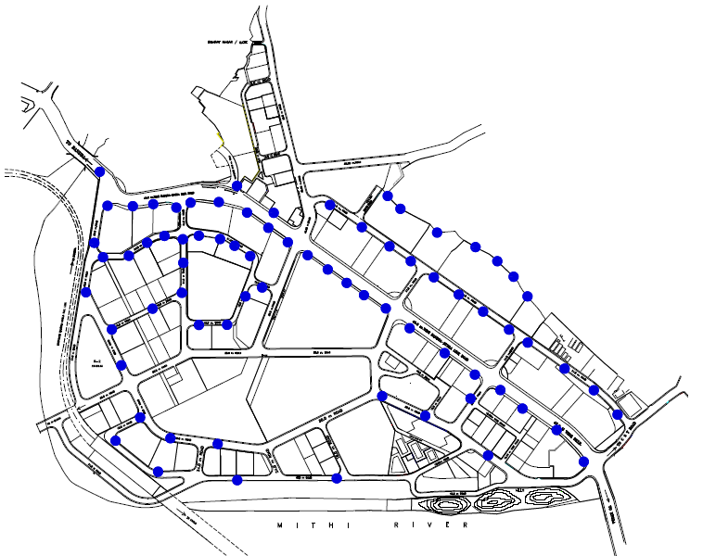
Location Analysis is also done for G Block to identify Wi-Fi access points locations to ensure carpet coverage
NSE
ILFS
ICICI
SEBI
MMRDA Grounds
IDBI
SBI
MMRDA Grounds
Bharat
Diamond Bourse
MMRDA Grounds
Reliance Ind. Ltd
EIH
US Embassy
Wireless Access Points*: 74
*Wireless access points have been identified in consultation with telecom service provider. Detailed feasibility study will be done during implementation

Slide 44
Smart parking with electric cart will save time, reduce emissions and provide last mile connectivity
Solution Details
Wi-Fi Sensor based Smart Parking solution will manage indoor, open and street parking
Smart Parking enables 1070 Car Parking spaces, 166 Buses Parking and 350 2-wheeler parking
Provision to enable 2000 more car parking spaces in future
Parking Guidance mobile/web app
Digital message board and maps to provide real time status of parking at entry and exit points
Electric cart will provide last mile connectivity from parking to key locations at nominal fee
Benefits
Impact
Provides real visibility on available parking to commuters through web/mobile/message displays
Increased revenue from parking services by improving utilization of parking spaces
Hassle free parking for premium and normal users.
Streamline the parking operations
7800 Man days saved per year
19000 Liters of Fuel saved annually
Increase Utilization of Parking areas
24 tonnes of Carbon Reduced Annually
Reduction in Unauthorized Parking
Parking Time Reduced from 20 minutes to 5 minutes

Slide 45
Commuters spend on an average 20 mins. looking for parking slots, which amounts to 92 tonnes of CO2e every year; also leading to unauthorized parking
Use Case
(Now and Future)
Case Studies
Design Architecture
Vendor Landscape
Financial Viability
Stakeholder Benefits
Location
Technology
There are currently 1070 four-wheeler parking spots, 350 two-wheeler spots and 166 bus spots spread over eight parking lots
There are 3000 additional parking spots that are currently under construction and will take 2-3 years to be available
The demand for parking spaces far outstrips the supply of them
Parking during peak timings in BKC is a frustrating experience with over 18-20 minutes spent circling looking for a parking space
The parking lots were tendered. The current parking process is manual. The parking attendant over charges people (INR 80 or INR 105 instead of INR 60).
Some of the parking lots are very far from the commercial area thus their tender process was not fulfilled because they could not meet revenue potential
A lot of street parking goes on illegally because of unavailability of parking spots
While towing of some cars happens, several cars remain parked thus making this a non-optimal way of realizing revenue
Plan
Issues
Smart parking will reduce the hassle that commuters to BKC currently have – the difficulty in finding a parking spot.
This will be addressed by the introduction of parking sensors in parking spots which detect the presence of a vehicle and then transmit this information to a smart parking server
A well designed app with a map that points out available parking spots
The smart parking initiative will be advertised during the first few months
Smart parking solution suggested does not cover non-tendered spots where a large fraction of illegal parking goes on
Uptake of the mobile application for smart parking might not find too many users unless it is designed with users ease of use in mind

Slide 46
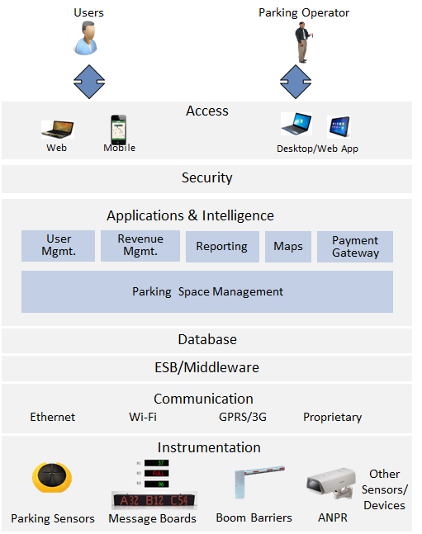
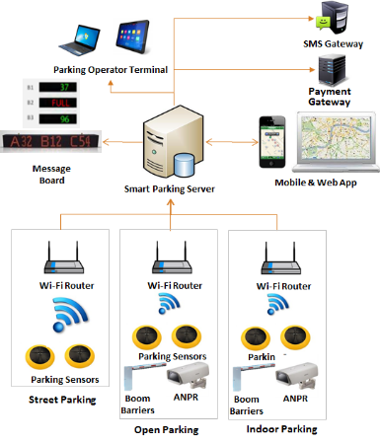
The smart parking base architecture has to be designed (Indicative)
Use Case
(Now and Future)
Case Studies
Design Architecture
Vendor Landscape
Financial Viability
Stakeholder Benefits
Application
Infrastructure
Sensors data will be captured through Wi-Fi routers and transmitted to parking server. Parking server will update the message board and maps frequently to provide real time parking space availability.
Parking space management, maps engine, user mgmt., revenue mgmt., reporting and payment gateway are key modules for Smart Parking application architecture.

Slide 47
Intelligent streetlights with solar panel will produce clean energy and reduce carbon footprint
Solution Details
Light & Motion sensors will turn on/off and adjust light brightness in night based on people/car movement.
Grid Tied Solar PV will generate clean electricity and feed to the grid. Gird can offset the payment based on electricity consumed vs generated.
LED lighting will reduce electricity consumption and offer more life thus reducing O&M.
CCTV cameras and Wireless routers can be installed on same pole to monitor road and maintain Wi-Fi.
Benefits
Impact
841 Streetlights modified
Solar panel will generate clean energy sufficient to cover approx. 25% of current street light energy requirement
Reduce maintenance costs for lighting equipment by replacing HPSV lamps to LED
Improved maintenance due to Automatic fault detection and alert
800 tonnes of Carbon Reduced Annually
Energy Consumption reduced by 40%
Reduced Maintenance Cost
200KW of clean energy generated
Reduced investment for
Wi-Fi and CCTV

Slide 48
Currently street lights in BKC consume around 850 kW of electricity resulting in INR 6.5 lakhs of electricity costs and 900 tonnes of CO₂e emissions
Use Case
(Now and Future)
Case Studies
Design Architecture
Vendor Landscape
Financial Viability
Stakeholder Benefits
Location
Technology
In total there are 841 streetlights with 1325 bulbs of differing wattages (150, 250 and 70W)
The street furniture is maintained and owned by Reliance which is the electricity provider.
The total electricity bill for the month comes up to nearly INR 6.5 lakhs
In addition to the electricity bill, MMRDA pays maintenance costs which brings the total to INR 14-16 lakhs
The lights remain on for 12 hours approx.
The streetlights in BKC are currently ordinary ones without any sensors
There are 4 types of streetlights with the number of bulbs ranging from one to four
The bulbs used are High Powered Sodium Vapor (HPSV) lamps.
The lights are turned on manually with no time or light sensitivity taken into consideration
Plan
Issues
With the addition of light and motion sensors the energy costs will reduce by about 40%
There is also a recommendation to replace the HPSV lamps with LEDs which will reduce the energy costs by 40%
Additionally solar panels can be placed on the streetlights and the energy generated fed back to the grid
Differing illumination levels may cause accidents
Reliance may not agree to purchase the solar power generated and supplied back to the grid
Panel needs to withstand the wind pressure and be cleaned on daily basis to ensure generation performance.

Slide 49
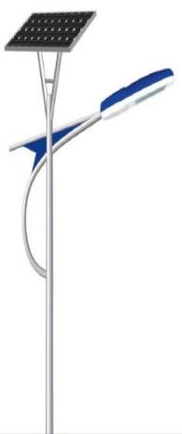
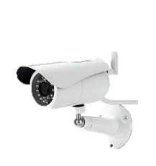
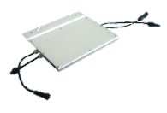
To address the lighting needs Sensor based lighting control with or without Solar panel options are evaluated
Use Case
(Now and Future)
Case Studies
Design Architecture
Vendor Landscape
Financial Viability
Stakeholder Benefits
Solution Options
Conceptual View
Sensor based lighting control
Sensor based lighting control + Gird Tied Solar PV
1. Sensors
2
Sensors for light, motion and object detection
Can be used for parking, streetlights or lumen adjustment
1
5
2. Grid Tied Solar PV
3
PV generates electricity which can be feed to grid
Grid can pay for power generated
4
3. LED Lights
LED lights consumes much less electricity to produce same amount of light as compared to HPSV lamps
LED lights have 4 times more life then HPSV.
Gird Tied Inverter
4. CCTV Camera
Camera for video surveillance
Can be used for security and monitoring
5. Wireless Router
Meter
Wireless router for Wi-Fi Hotspots
The could be installed as necessary in areas
Grid
Notes:
The Karnataka Energy Regulatory Commission (KERC) has recently announced rates at which the electricity companies (ESCOMs) in Karnataka, will buy excess solar energy from individuals and commercial establishments.
http://bangalore.citizenmatters.in/articles/installing-domestic-solar-plants-some-questions-and-answers

Slide 50
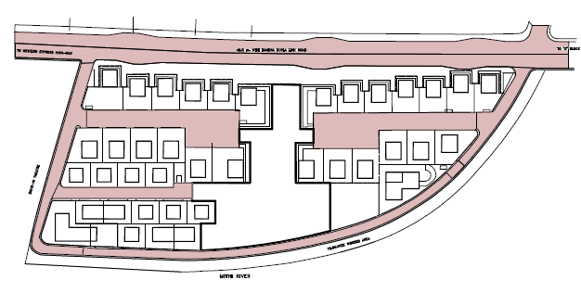
Location Analysis – E Block
Family Court
RBI
Income Tax Office
MMRDA
Sales Tax
Food
Plaza
CMC
MSEB
IB
CE
AG
School Plot
Wattage (HPSV) | No. of streetlights | Bulbs | Total
150 | 189 | 1 | 189
150 | 190 | 2 | 380
150 | 34 | 3 | 102
250 | 229 | 1 | 229
250 | 168 | 2 | 336
250 | 21 | 3 | 63
250 | 3 | 4 | 12
70 | 7 | 2 | 14
 | 841 |  | 1325
BKC Park

Slide 51
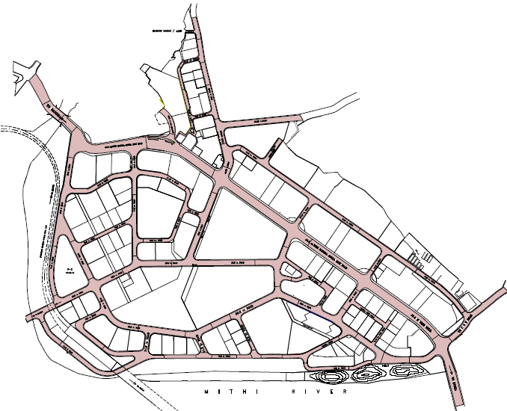
Location Analysis – G Block
Wattage (HPSV) | No. of streetlights | Bulbs | Total
150 | 189 | 1 | 189
150 | 190 | 2 | 380
150 | 34 | 3 | 102
250 | 229 | 1 | 229
250 | 168 | 2 | 336
250 | 21 | 3 | 63
250 | 3 | 4 | 12
70 | 7 | 2 | 14
 | 841 |  | 1325
NSE
ILFS
ICICI
SEBI
MMRDA Grounds
SBI
MMRDA Grounds
IDBI
Bharat
Diamond Bourse
MMRDA Grounds
Reliance Ind. Ltd
EIH
US Embassy

Slide 52
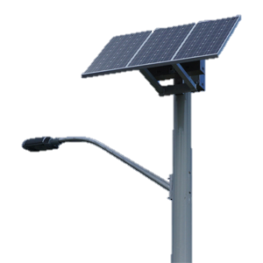
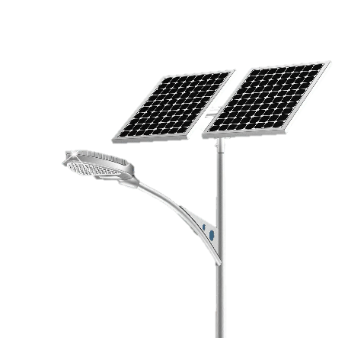
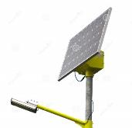
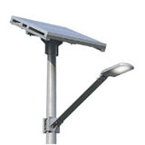
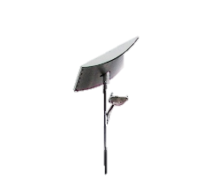
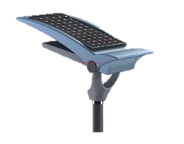
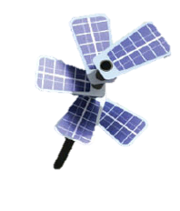
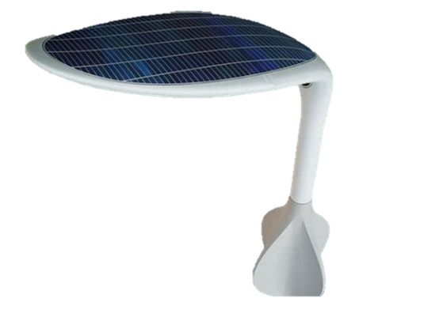
Aesthetics of Solar Panels for Streetlights
Conventional Designs
Modern Designs

Slide 53
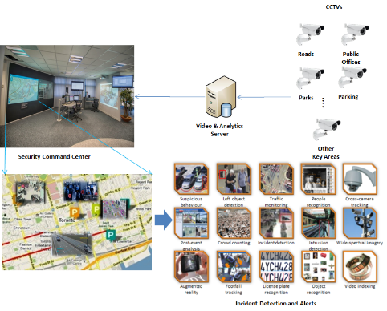
To address security issues it is proposed to install an advanced video analytics solution
Use Case
(Now and Future)
Case Studies
Design Architecture
Vendor Landscape
Financial Viability
Stakeholder Benefits
Solution Details
Conceptual View
Smart surveillance consists of cameras overlaid with video analytics that analyze the feed supplied by the cameras in real time and point out anomalies based on the instances programmed in it.
The video analytics server will process the information and display the outcomes in the command center.
Auto traffic monitoring, crowd counting, people and object recognition, Street furniture theft, left baggage etc.. would augment existing security measures
Benefits
Video Analytics will provide proactive threat detection
Help in reducing the street furniture theft
Help security agencies spot incidents, respond quickly, and gather evidence
Improve operations and effectiveness: Detected events are automatically analyzed, and aggregated into meaningful business alerts, enabling the Operation Centre to respond in a quick and efficient way
These video services can help monitor footfall, security incidents, detect left objects, report suspicious activities etc..
Video Feed can be shared by multiple agencies like MMRDA, Police, Fire etc..
SMS alert will alert respective agency in case of emergency situation

Slide 54
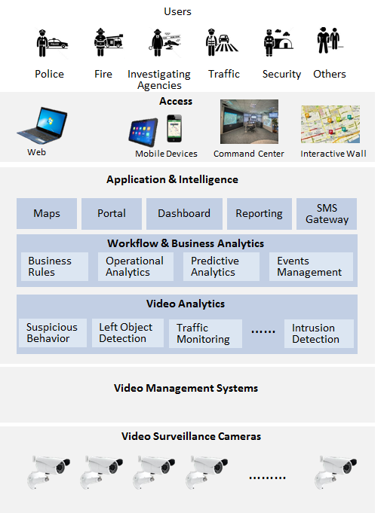
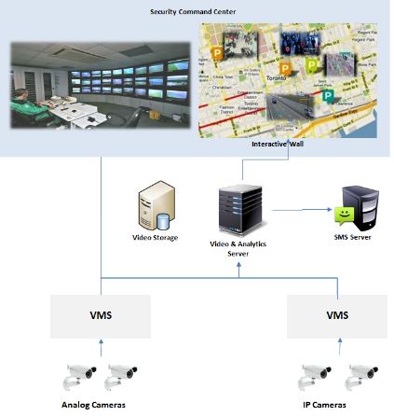
Video analytics architecture would enable integration of multiple VMS and both analog and IP cameras based analytics (Indicative)
Use Case
(Now and Future)
Case Studies
Design Architecture
Vendor Landscape
Financial Viability
Stakeholder Benefits
Application
Infrastructure

Slide 55
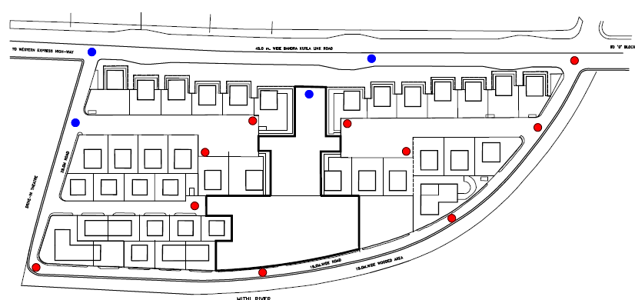
Location analysis is performed to identify the placement of security cameras in E- Block to ensure optimum video surveillance
Use Case
(Now and Future)
Case Studies
Design Architecture
Vendor Landscape
Financial Viability
Stakeholder Benefits
4F
1P, 4F
1P,4F
3F
Family Court
RBI
Income Tax Office
1P,3F
1F
1F
1P,2F
MMRDA
Sales Tax
1F
Food
Plaza
1F
IB
CE
AG
CMC
MSEB
1F
School Plot
BKC Park
1F
2F
2F
2F
Security cameras suggested: 2 PTZ + 18 fixed cameras
Mumbai CCTV cameras: 2 PTZ + 14 fixed cameras
Total cameras in BKC: 4 PTZ +32 fixed cameras
Total cameras suggested in this project: 2 PTZ + 18 fixed cameras
(not including Mumbai CCTV)
Security Cameras suggested
Mumbai CCTV Security Cameras
Camera locations are decided based on field visit and office area coverage
We are proposing analytics for 20% of cameras. For Mumbai CCTV 1% of the cameras are proposed to have video analytics but it is unknown whether any BKC cameras will be among them

Slide 56
Similar analysis is done to identify the placement of security cameras in G-Block
Use Case
(Now and Future)
Case Studies
Design Architecture
Vendor Landscape
Financial Viability
Stakeholder Benefits
Security Cameras suggested: 10 PTZ + 42 fixed
Cameras on movable poles that will be reserved for MMRDA grounds to provide adequate coverage: 5 PTZ + 10 fixed
Mumbai CCTV cameras: 6 PTZ + 41 fixed
Total number of cameras in BKC: 21PTZ + 93 fixed
Total suggested by the project: 15 PTZ + 52 fixed
(not including Mumbai CCTV)
4F
1P,2F
1P,3F
NSE
ILFS
ICICI
1P,5F
SEBI
1P,4F
MMRDA Grounds
SBI
1P,4F
1P,3F
IDBI
2F
MMRDA Grounds
1P,3F
3F
Bharat
Diamond Bourse
1P,4F
1P,3F
MMRDA Grounds
1P,4F
1P,4F
1P,3F
Reliance Ind. Ltd
3F
EIH
2F
1P,7F
3F
US Embassy
3F
4F
1P,8F
1P,4F
3F
1P,3F
Security Cameras suggested
Mumbai CCTV Security Cameras
Camera locations are decided based on field visit and office area coverage
We are proposing analytics for 20% of cameras. For Mumbai CCTV 1% of the cameras are proposed to have video analytics but it is unknown whether any BKC cameras will be among them

Slide 57
The technical architecture of the Citizen App will leverage the open App development platform which reduces the development effort for multiple platform ( Indicative)
Use Case
(Now and Future)
Case Studies
Design Architecture
Vendor Landscape
Financial Viability
Stakeholder Benefits
Application
Infrastructure

Slide 58
The design architecture for the combined solution will be based on an open platform
Use Case
(Now and Future)
Case Studies
Design Architecture
Vendor Landscape
Financial Viability
Stakeholder Benefits
Access
Portal
Mobile App
Shared Services
Processes
Wi-Fi
Intelligent Streetlight
Smart Parking
Video Analytics
Citizen App
Registration & Authentication
Solar Power Monitoring
Registration (Premium User)
Alerts Mgmt.
Registration
CRM
Billing
Ticketing & Billing
Response Management
Information Mgmt.
User Management
Payment
Alerts Mgmt.
Lighting Control
Parking Space Mgmt.
Maps/GIS
Wireless mgmt.
Complaints Mgmt.
Security
SMS Gateway
Applications & Intelligence
Analytics
Events Management
Reporting & Dashboards
Workflow
Email Gateway
Database
Billing
ESB
Communication
Payment Gateway
Wi-Fi
Fiber
Ethernet
Instrumentation
Mobility Platform (Ex. Phonegap etc..)
Other Sensors/ Devices
Wi-Fi Access Points
Lighting, Solar, Meter
Parking, Sensors, VMS…
CCTV

Slide 59
To achieve the vision for an intelligent BKC it is recommended that MMRDA implements all five initiatives as part of phase 1 – this will improve the quality of life for stakeholders of BKC
Use Case
(Now and Future)
Case Studies
Design Architecture
Vendor Landscape
Financial Viability
Stakeholder Benefits
AFTER
The consolidated solution is beneficial to stakeholders from a Use case perspective
Rahul wakes up in the morning and checks his BKC citizen app for updates on traffic etc..
There are no emergency alerts or traffic diversions. It looks like its going to be smooth sailing
The new LED streetlights with the solar panels make sure his way back home is safe at night
Wi-Fi
Smart Parking
The consolidated solution is financially self sustainable in the long term
On his way he catches up on email on the free Wi-Fi that his citizen app connects to seamlessly
As he leaves for work he pulls up his app and reserves a parking space at a lot close to his office
Intelligent Streetlights
Video Analytics
BKC – Smart City
Use of combined architecture ensures seamless experience and synergetic cost saving opportunity
The money automatically gets debited from his e-wallet
He reaches BKC, parks his car and rides the electric cart to his office
As he nears BKC he slows down to match the speed limit – the video cameras installed have name plate recognition
But they are a blessing because crime in the area has dropped considerably since the cameras’ installation
Citizen App

Slide 60
Once phase 1 solutions have been implemented additional initiatives can be build upon the existing capabilities
Use Case
(Now and Future)
Case Studies
Design Architecture
Vendor Landscape
Financial Viability
Stakeholder Benefits
Wi-Fi
Smart Parking
Intelligent Streetlight
Video Analytics
Citizen Mobile Application
BKC Wide Wi-Fi
Communication Backbone for Parking Sensors, CCTVs, Kiosks
On Street, Open and In Door Parking
Parking Guidance App
Parking Space Management
Parking Reservations
Lighting
Light & Motion Sensor
Solar
200 kw Grid Tied Solar PV
50 new cameras to cover entire BKC
Integration with Mumbai CCTV
Command Center at MMRDA and BKC Police St.
BKC Information
Key Contacts
Citizen Involvement Mobile App
Kiosks
Extend for more Smart City Apps
Air Pollution Sensors
Smart Meter (Electric/Water/Gas)
Water Quality Meters
Flood Sensors
EV Charging Stations
EV Charging Station Locator
Differential Parking Charging
Lighting
LED Retrofit Lighting
Solar- expand to 1 MW
Solar PV on Buildings (Terrace and Façade)
Solar PV on Bus Stops
Extend Command center at MMRDA to City Command Center
Feed to Transportation Planning
Citizen Involvement in Planning
Citizen Services -GIS and ERP Integration

Slide 61
To achieve the vision for an Smart BKC MMRDA envisages implementation of all five initiatives as part of phase 1 – this will improve the quality of life for stakeholders of BKC
AFTER
The consolidated solution is beneficial to stakeholders from a Use case perspective
Rahul wakes up in the morning and checks his BKC citizen app for updates on traffic etc..
There are no emergency alerts or traffic diversions. It looks like its going to be smooth sailing
The new LED streetlights with the solar panels make sure his way back home is safe at night
Wi-Fi
Smart Parking
The consolidated solution is financially self sustainable in the long term
On his way he catches up on email on the free Wi-Fi that his citizen app connects to seamlessly
As he leaves for work he pulls up his app and reserves a parking space at a lot close to his office
Intelligent Streetlights
Video Analytics
BKC – Smart City
Use of combined architecture ensures seamless experience and synergetic cost saving opportunity
The money automatically gets debited from his e-wallet
He reaches BKC, parks his car and rides the electric cart to his office
As he nears BKC he slows down to match the speed limit – the video cameras installed have name plate recognition
But they are a blessing because crime in the area has dropped considerably since the cameras’ installation
Citizen App

Slide 62
Smart BKC Plan- Phases
MMRDA has started its Smart City journey with focus on creating BKC as Smart Region and identified Top 5 solutions to create foundation for Smart BKC.
Smart BKC 3.0
Futuristic Initiatives
Smart BKC 2.0
Advanced Initiatives
Smart BKC 1.0
Foundation Initiatives
Congestion Charging
Interactive Sidewalk
Urban Incubation Center
Car Pooling System
Electric Vehicle Charging System
Intelligent Buildings
Smart Meters
City Command Center
Pollution Monitors
Energy & Water Efficiency
Intelligent Streetlight
Video Analytics
Smart Parking
Citizen App
Wi-Fi

Slide 63
Select Case Global Studies

Slide 64
Smart Mexico
http://www.youtube.com/watch?v=yebCSuZCusc

Slide 65
Smart London
Digital Design Authority accountable for developing the data dictionary and the translation capability to pool the urban information into a common platform, exposing it in open protocols to local residents, businesses and the Future Cities Catapult
Intelligent Heat Pathways to realize the value of district heat networks
Neighborhood Systems to improve energy efficiency in households
Adaptive Urban Logistics to address congestion and pollution
Real-time Asset Visualizations to provide a holistic digital view of infrastructure
Micro-work Platforms to support employment and career-building in disadvantaged communities.
Smart London Advisory Board – external advisory group to steer the project

Slide 66
Public Wifi : Barcelona,Spain
1 OF THE 800 WIFI ACCES POINTS

Slide 67
SMART LIGHTING, Barcelona, Spain
Goal
To ensure the criteria of light (color temperature levels, uniformity, contrast, etc..) that makes the city lighting more efficient.
Description
Implement a lighting plan which follows the guidelines of the smart lighting concept, i.e. a technology designed lighting for energy efficiency.
Strategic Projects
Master Lighting Plan
Sensors

Slide 68
ENERGY SELF-SUFFICIENCY, Barcelona, Spain
Goal
Promoting a complete energy autonomy , including buildings.
Description
Set of actions aimed at producing and consuming the own energy by raising awareness among the population.
Strategic Projects
Self-sufficient buildings
Smart grid
Cooling & Heating Network
Energy self-sufficient Catalogue
Electric Smart metering
BESOS ¹
Arrowhead ¹
Wind Tower

Slide 69
SMART WATER, Barcelona, Spain
1 of the 178 monitored watering gardens
Taulat promenade corner Josep Pla Gradens, Barcelona

Slide 70
SMART WATER, Barcelona, Spain
Goal
Providing a smart management of the city’s hydric resources, either for phreatic water and groundwater management or in a rational consumption of the public services (irrigation and fountains).
Description
Automatizing, testing and remotely controlling the irrigation systems, fountains and sewerage in order use hydric resources in a more efficient way.
Strategic Projects
Remote irrigation
Smart Sewer
Water table management
Remote ornamental fountains
Pilot metering telemetry water

Slide 71
Clean Technology , Smart Technology,
ZERO EMISSIONS MOBILITY, Barcelona, Spain
Goal
Transforming electric vehicles in the benchmark for individual, collective, public and/or private transport in Barcelona
Description
Develop systems of mobility which are electric, sustainable, efficient, 0 emissions and minimum public space occupation.
Strategic Projects
Zero emissions mobility – Electric Vehicle

Slide 72
SMART PARKING & TRANSPORTATION, Barcelona, Spain
Goal
Developing parking systems that help the driver finding available spots to park their vehicle in the most efficient and fast possible way in order to improve urban mobility.
Description
Signaling available spots with lights and designing mobility lines following sustainability, viability, efficacy and efficiency guidelines.
Strategic Projects
Vehicle guideway system
Public space use
Sensorization & Identification: New services Les Corts district pilot
Mobility Plan
Ortogonal Bus Network
Smart Parking
Micro distribution of goods

Slide 73
SMART LOGOSTICS, Barcelona, Spain
MICRO DISTRIBUTION OF GOODS
Arc de Triomf, Barcelona

Slide 74
INTELLIGENT URBAN FURNITURE, Barcelona, Spain
Goal
Redesigning public objects installed in Barcelona to make them more sustainable.
Description
Designing urban furniture following smart city criteria and strategy (Livability, Viability and Sustainability).
Strategic Projects
Smartquesina
Kioskos
Cyclist Panel

Slide 75
INTELLIGENT URBAN FURNITURE, Barcelona, Spain
SMARTQUESINA IN SMART BUS SHELTER – TABLET
Gran Via Fair, Barcelona

Slide 76
Citizen Facilitation Centre, Barcelona, Spain
VIRTUAL CITIZEN CARE OFFICE
Casa del Mig 2, Barcelona

Slide 77
BARCELONA IN YOUR POCKET, Barcelona, Spain
Goal
Fostering the use of mobile technologies to access city services, boost mobile industry and place Barcelona as a mobile technology reference.
Description
Develop and promote apps aimed at easing and enriching the lives of Barcelona’s residents and visitors.
Strategic Projects
Barcelona Contacless
Apps
Digital Identity
Apps4bcn

Slide 78
OPTIMISED WASTE COLLECTION, Barcelona, Spain
Goal
Optimize the urban waste management.
Description
Provide a smart automatized system to collect waste and improving the recycling rates.
Strategic Partners
Optimised waste collection
Green mobile point

Slide 79
OPTIMISED WASTE COLLECTION, Barcelona, Spain
1 OF THE 90 GREEN MOBILE POINT STOP
Joan Sales / Poesia Mondays from 16:00 to 19:30h

Slide 80
EDUCATION, Barcelona, Spain
Goal
Promote, train and make kids become familiar with mobile technology.
Description
Develop all kinds of mobile initiatives at school and in other spheres providing the right material (tablets, sensors, etc.).
Strategic Projects
Educat
mSchools
Raspberry BCN
4DLife
Smart Vegetable Garden
Mobile Social Day

Slide 81
M-Schools, Barcelona, Spain
mSCHOOLS
School in Barcelona

Slide 82
City wide Wi-Fi- Singapore and Australia
Wireless@SG, Singapore
Singapore government’s initiative, Wireless@SG, launched in 2006, to accelerate the deployment of high-speed wireless broadband, promote wireless broadband lifestyle amongst citizens and catalyze the wireless broadband market in Singapore
The access speed was doubled to 1 Mbps in September 2009 and the Seamless and Secure Access (“SSA”) was implemented in 2010 to simplify the log-in process and gives users the “always-on” function in a hassle-free manner
As of December 2012, there are 2.26 million subscribers. Usage hours have also increased to an average of 31 hours per user per month in 2012
Several enhancements are being planned over the next phase of expansion for the service
Blanket Wi-Fi in CBD, Perth
The City of Perth offers free public Wi-Fi around their Central Business District (CBD). The service allows users to connect to the internet for basic browsing
The ‘Perth Wi-Fi’ internet service provides blanket coverage over the CBD area which means once you connect you can roam the city streets and remain connected
This is enabled through a series of hubs around the city that extend the Wi-Fi from one area to another
It has cost $300,000 to install with a further $150,000 set aside annually for improving services
Users have a download limit of 50mbs per connection. Once this limit is reached users will need to reconnect to the service
If users do not exceed their download limit they can remain connected to the network for an hour. After an hour users will need to reconnect
http://www.ida.gov.sg/~/media/Files/Archive/News%20and%20Events/News_and_Events_Level2/20090728165354/WirelessSG_factsheet.pdf
http://www.perth.wa.gov.au/newsroom/featured-news/australian-first-%E2%80%93-free-blanket-wifi-perth-cbd

Slide 83
Smart parking, San Francisco, London
SFpark, San Francisco
SFpark uses a combination of technology and governance structures to improve parking in the downtown San Francisco region. Using real-time information, SFpark finds available parking spaces for drivers, which decreases the time spent driving around the city centre. In addition, parking is dynamically priced to match demand, which help encourages drivers to park in underused areas and garages, reducing demand in the city centre.
SFpark also has extended time limits and additional payment options for drivers which is expected to lead to a decrease in parking violations and fewer parking tickets. Data from the sensors may also be used to adjust parking enforcement officers schedules and routing.
SFpark is currently being trialled at 7,000 out of the total 28,000 of San Francisco’s metered parking spaces, and 12,250 spaces in 15 of the 20 city-owned parking garages.
Smart Parking Trial, London
The City of Westminster in London is trialing a new smart parking system to help alleviate traffic and direct drivers to unoccupied spaces. Currently Westminster has 12,000 parking spaces, and it is estimated that 30% of traffic flow is due to motorists looking for a parking space. In addition, 15% of spaces remain unoccupied because drivers are unaware of their location.
The trial solution involves wireless sensors monitoring the occupancy of each parking space, which transmit the information to a smartphone app, allowing users to see the number of parking spaces available on any given street, in real time.
With this information, drivers can plan their route to available parking spaces which reduces the time spent looking for a spot. As a result, congestion caused by circling is significantly decreased.
http://www.translink.ca/~/media/Documents/plans_and_projects/regional_transportation_strategy/Research/Parking_Management.ashx
http://www.dailymail.co.uk/news/article-2184174/The-app-parking-space-Street-sensors-alert-drivers-bay.html

Slide 84
Video analytics- Singapore, UK
Singapore Safe City Testbed
The Singapore Safe City Testbed is a government initiative seeking industry partners to integrate advanced analytics into existing sensors and systems owned by different agencies, in order to maximize situational awareness, streamline operations and enhance response to a wide spectrum of safety and security concerns
Accenture will deploy its Video Analytics Service Platform, a layered service-based solution that will connect to existing and new sensor infrastructures – including 70 CCTV cameras owned by four different organizations, apply computer vision and predictive analytics to surveillance video feeds to detect various events, and generate business alerts that will be sent to the relevant government agencies
Leveraging many different sensor-based and advanced data analytics, this system will enable to detect and monitor a variety of situations, such as crowd movement anomalies, urban traffic, disturbance to public order, etc.. – enabling agencies to gain situational insights from systems otherwise not accessible to them
Image
UK Police Force Riot Investigation
In 2011 when the riots occurred in the UK the police had large amounts of CCTV footage and photos of known suspects but police search mainly relies on manual inspection and tips from the public
Accenture assessed the feasibility of automating the search using biometrics. The UK police provided 800,000 custody photos and 250 CCTV images
Biometric search and adjudication tools narrowed the suspect list from 800,000 to 800 which was further whittled down to 8 by manual adjudication
Biometric search also helped link custody images thus identifying new repeat offenders
http://www.mha.gov.sg/news_details.aspx?nid=MjgyNg%3D%3D-WVlit5hncaY%3D
http://www.accenture.com/SiteCollectionDocuments/Accenture-Business-Biometrics.pdf

Slide 85
With high penetration of mobile phones in India, an App solution is one of the most effective ways to access information
Birmingham City Council mobile web app, UK
The free BCC mobile app provides the following services:
Browse council jobs
Find and get directions to any leisure centre, library, school, museum, or household recycling centre in the city
Keep up with BCC news and any disruption to services
Get contact details for your councilor
Report a problem with rubbish bags or recycling boxes
Request street cleaning
Report faulty street lights and street name plates
Request recycling boxes if you are a new occupier
Report dumped rubbish (fly-tipping)
Report a missed rubbish collection
Report a pot hole
My Croydon App, UK
The new My Croydon app is a faster way to report issues to the city using a smartphone.
Using the app citizens can report a variety of local issues such as fly-tipping, defects on the highway or problems with trees and high hedges.
All that needs to be done when a problem is seen is:
Select the issue that one wants to report (such as graffiti) from a drop-down list and add any other relevant information that the city needs to know
Take a photo of the problem
Add the location
Submit the report
For people without a smartphone they can also report issues to the city using the website at any time that suits them by signing up to My Account.
http://www.birmingham.gov.uk/app
http://croydon.gov.uk/democracy/communications/app

Slide 86
Intelligent streetlights, Netherlands, Australia
Adaptive Street lighting in Eeneind, Netherlands
The historic village of Eeneind in the municipality of Nuenen, Netherlands is a scenic town with rural surroundings
The challenge was to install motion sensors in the streetlights while maintaining the 19th century feel of the place
To meet this challenge, sensor based units (CitySense) were installed on street lights throughout the village
The units dim the lights (to 20%) when there is no activity in the streets, and increase the brightness to 100% upon the detection of a pedestrian, cyclist or a car
The CitySense units communicate with neighboring units over a wireless mesh network telling them to also increase their brightness
Using Tvilight's web-based remote management software, CityManager, the municipality now has the ability to control the dimming levels, the lamp hold time and other settings, ensuring comfortable and safe light levels while achieving excellent energy savings
Grid Connected Streetlights in Victoria, Australia
A sustainable Mornington Peninsula housing estate has installed grid connected solar powered residential street lighting in Victoria, Australia
The solar panels above each light feed electricity into the grid during the day
At night the lights take a smaller amount of power back out of the system to illuminate the streets
Public lighting is responsible for 30 per cent of local government greenhouse pollution
It is also estimated the solar lights in the estate will save around $700 in energy costs every year
The Orchard Grove estate street lights are driven by clean, green renewable energy, so will contribute significantly to the shire's sustainability
http://www.tvilight.com/projects/city-nuenen/
ftp://seav.vic.gov.au/news_old/media_releases/20030908_2.pdf
Notes:
http://www.tvilight.com/projects/city-nuenen/
ftp://seav.vic.gov.au/news_old/media_releases/20030908_2.pdf

Slide 87
SAFETY & SECURITY, Barcelona, Spain
Goal
Keeping the public space and ICT systems safe.
Description
Protect places (airports, harbours, railway stations, tunnels, stadium, and other public avenues) and ICT technologies.
Strategic Projects
Beach Connectivity: Sound System
eSecurity

Slide 88
Kuala Lumpur’s Financial District

Slide 89
E-Governance in MMRDA

Slide 90
Implementation of e-governance in MMRDA
Background
GOI formulated National e-Governance Plan, GOM formulated State e-Governance policy to support e-governance initiatives
GOM empanelled consulting firms to support departments in their e-Governance initiatives implementation
GOM Issued GRs for mandating e-tendering, e-office, Scanning & Digitization and Citizen Centric interface
Engagement of Consultant, Formation of Committee to fast track the eGovernance
MMRDA envisaged implementation of e-governance initiatives in Phase-1 and 2
MMRDA selected M/s Accenture as e-Governance Consultant in April 2012 as per GOM GR for Phase-1 implementation
Project Implementation Committee, Bid Evaluation Committee, Nodal Officer & Technical Advisory Committee identified by MMRDA

Slide 91
MMRDA IT Vision
Improve Internal Efficiency, Transparency, Service Delivery & Introduce Standardization of process across MMRDA:
To achieve the vision, MMRDA envisaged two phased approach
Phase-1 : Basic IT Infrastructure- Server room, LAN, Hardware, Website, e-tendering, 34 MBPS Internet Connectivity, Payment, SMS and e-mail gateway, Scanning & Digitization, Exhibition Land Module, R&R Database, Video Conferencing, e-Office
Phase-2: Advanced Initiatives- ERP, Smart BKC 1.0, Enterprise GIS, Building Plan Approval, Digital MMR, Regional Information System

Slide 92
Phase-1 & Phase-2
Phase-2
Core Solutions
Smart BKC Initiatives
Completed
In Process
Phase-2 Initiatives
ERP
Enterprise GIS
Online Building Plan approval
Capacity Building
e-Office
Upgraded Hardware
Scanning & Digitization
Phase-1
Basic IT Infrastructure
MMRDA WebPortal
e-Tendering Solution
Exhibition Land Booking
LAN, MPLS, Internet & FMS
E-Mail, Payment, SMS Gateway
R&R Database for Tenement, PAP
Document Management System
Employee Master Database

Slide 93
Awards & Accolades
Awards & Accolades awarded to MMRDA for Phase-1 Initiatives
E-Tendering Solution
Skoch Renaissance Awards
Skoch Digital Inclusion Awards
eINDIA Awards
Document Management System
EDGE Awards
Exhibition Land Booking Module
Skoch Digital Inclusion Awards
Smart BKC
Skoch Renaissance Awards

Slide 94
MMRDA 3 Year IT Roadmap
In order to realize the IT Strategy , MMRDA has defined 3 year Strategic IT Roadmap to implement key initatives
2014
2015
2016
2017
Onwards
Internal Efficiency & Service Delivery Improvement
Basic IT- LAN, FMS, HW
Nov 2014
ERP
Dec 2015
GIS, Building Plan App.
Dec 2015
eOffice
Mar 2014
Value Creation
Wi-Fi
Jan 2016
Citizen App
Smart Parking
Aug 2016
Intelligent Streetlight
Video Analytics
Digital MMR

Slide 95
Financial Strategy by MOUD for Smart Cities – Estimated Investment
The analysis of the HPEC (High Power Expert Committee) on Investment estimates in urban infrastructure has asses a Per Capita Investment Cost (PCIC) of Rs 43,386 for a 20 year period.
Using an average of 1.0 million people in each of the 100 smart cities, the total estimate of investment requirements for the services covered by HPEC comes to Rs7.0 lakh crores over 20 years (with an annual escalation of 10% from 2009-20 to 2014-15).
This translates to the annual requirement of Rs 35,000 Crores.
Of the funds allocated to each Smart Cities by the Central Government, roughly 60% will be earmarked for investment in infrastructure and 10% for e-governance initiatives.

Slide 96
Fund Raising by MOUD for Smart Cities Suggested Financing Sources
Pooled Municipal Debt Obligation (PMDO) facility:
This facility was set up in 2006 with the participation of several Banks to promote and finance infrastructure projects in Urban Area on shared risk basis. Present corpus of the facility is Rs 5,000 Crore
Real Estate Investment Trusts (REITS):
REITS has been successfully used as instruments for pooling of investment in several countries. These structures would reduce the pressure on the banking system while also making available fresh equity.
Infrastructure debt funds (IDFs)
IDFs could be directed to invest in highly rated municipal bonds/green bonds by defining these as eligible investments. As IDFs are required to invest in post construction assets they could be used as a means to re-finance debt taken during the construction phase as well as additional monies for financing operations
Municipal bonds
Encourage issuance of tax-free municipal bonds by creditworthy local governments to bring down the cost of borrowing

Slide 97
Thank You
Mr. Shankar Deshpande,
In-charge, Information Technology Cell
Mumbai Metropolitan Region Development Authority
2nd Floor, A wing
Bandra Kurla Complex
Bandra (East), Mumbai- 400-051
Tel: 022-26595919
Fax: 022-26595943
Email: itcadmin@mailmmrda.maharashtra.gov.in jpdtp@mailmmrda.maharashtra.gov.in

